Slide 1
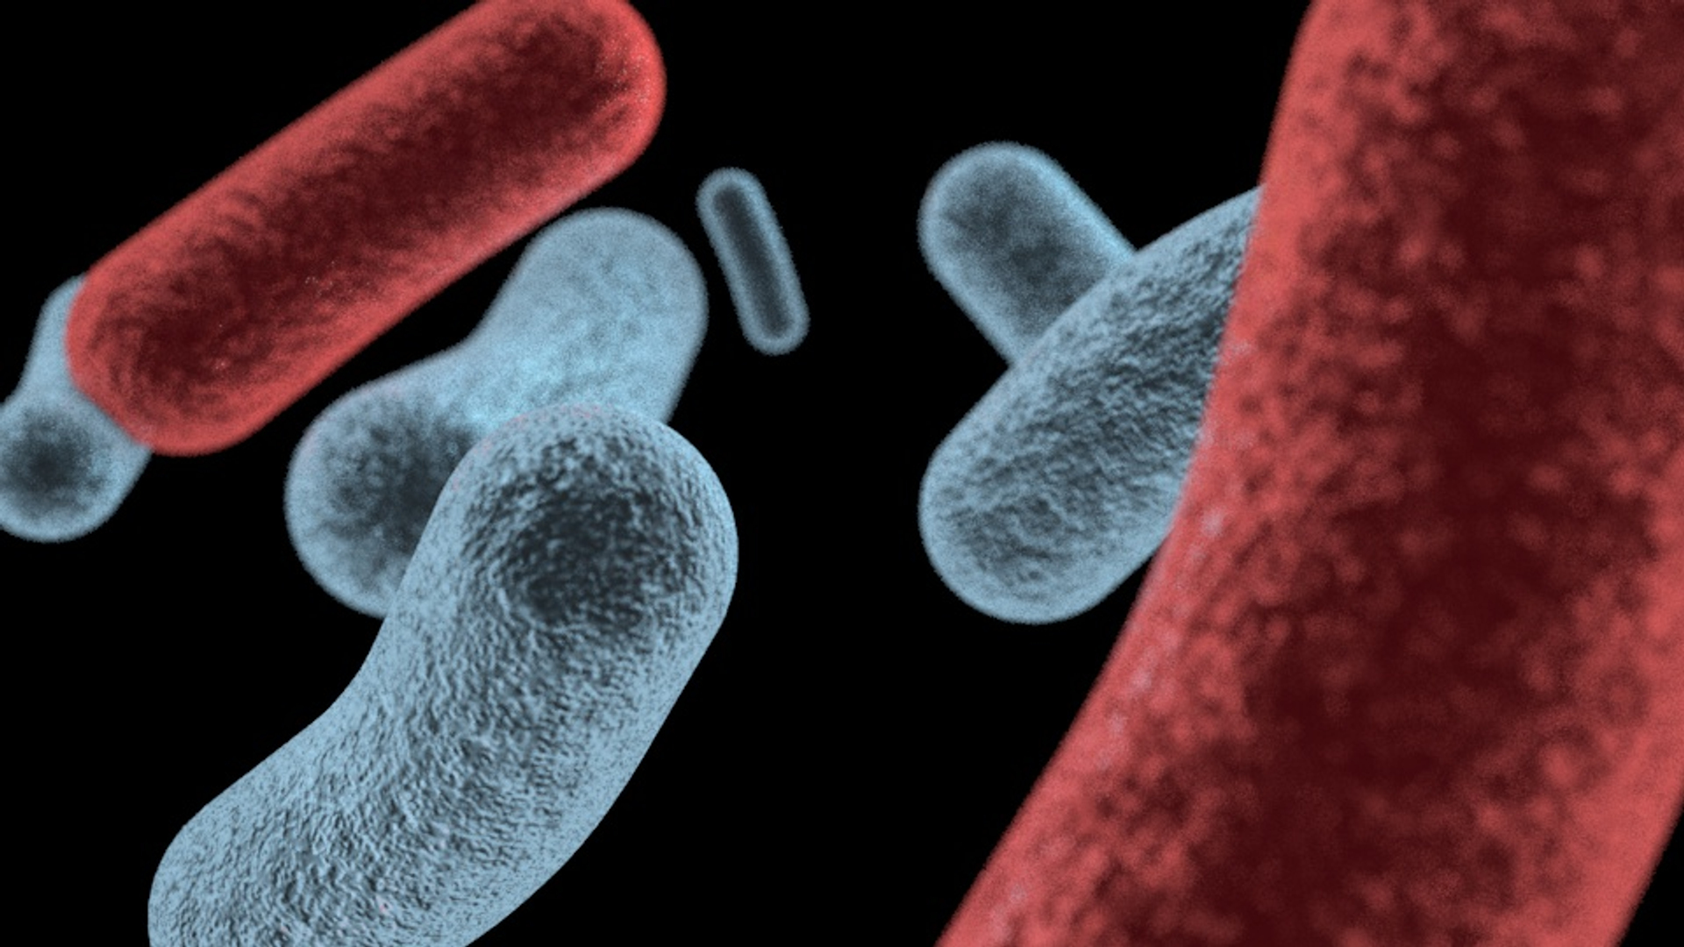
Prokaryotic Cells :
Bacteria
Presented by Dr. Aouati Amel

Slide 2
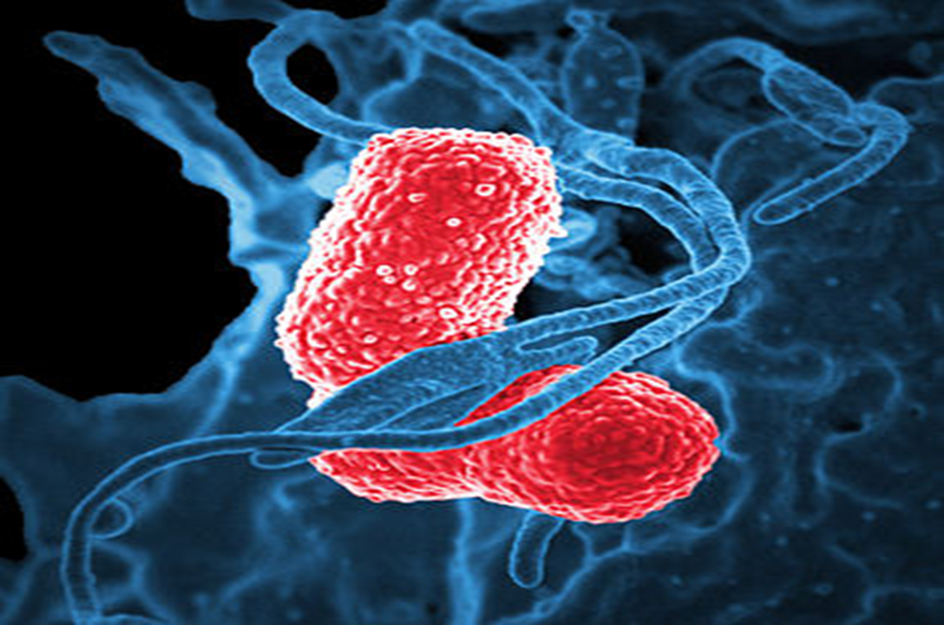
Bacteria are Prokaryotic living microorganisms, unicellular.
Bacteria are generally visible only with a microscope. from about 0.5 to 5.0 micrometers (µm) in length, though some species can be much larger, like the recently discovered Thiomargarita magnifica, reaching lengths of up to 2 cm, or even smaller, down to 0.3 µm for some Mycoplasma.

Slide 3
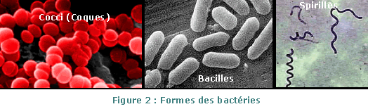
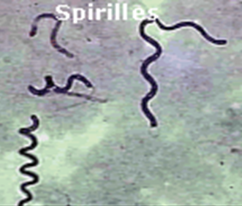
They can have different shapes:
- spherical shapes (cocci)
- rod-shaped shapes (bacilli)
- more or less spiral shapes (spirillae)

Slide 4
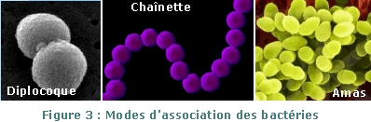
Many bacterial species can be observed in isolated unicellular form, while other species are associated with each other.
associated in pairs (diplococci)
associated in a chain
associated in a cluster

Slide 5
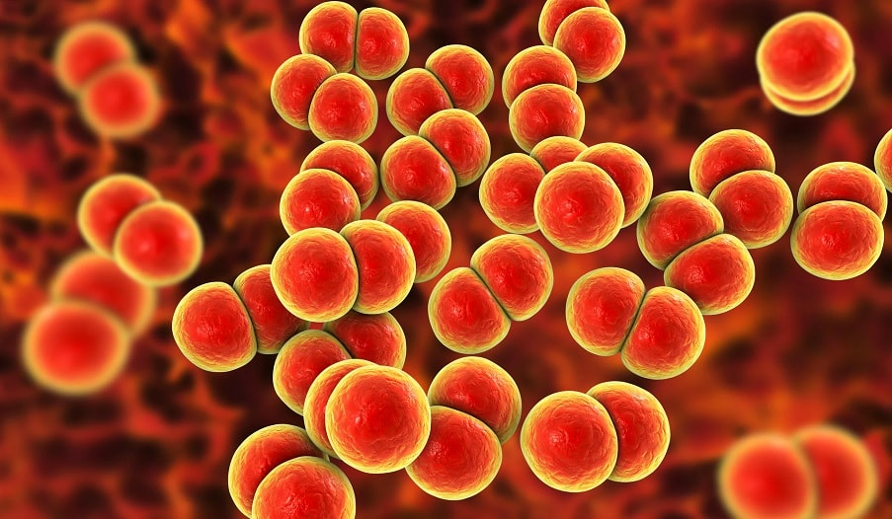
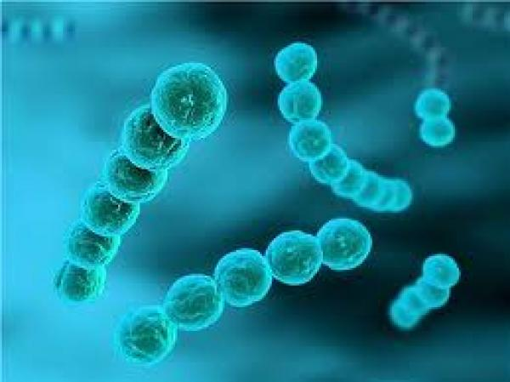
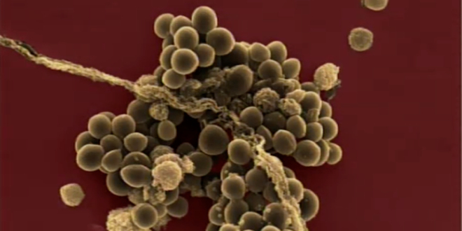
Spherical shapes (cocci)
When cells divide in a single plane, they give rise to two associated cells, these are diplococci, such as pneumococci, gonococci, and meningococci.
When this mode of division continues regularly, the cocci produce a long chains which characterize streptococci.
When division occurs in all 3 directions, cocci form asymmetrical clusters (clusters) such as staphylococci
Neisseria gonorrhoeae
Streptococcus B
staphylococcus aureus

Slide 6
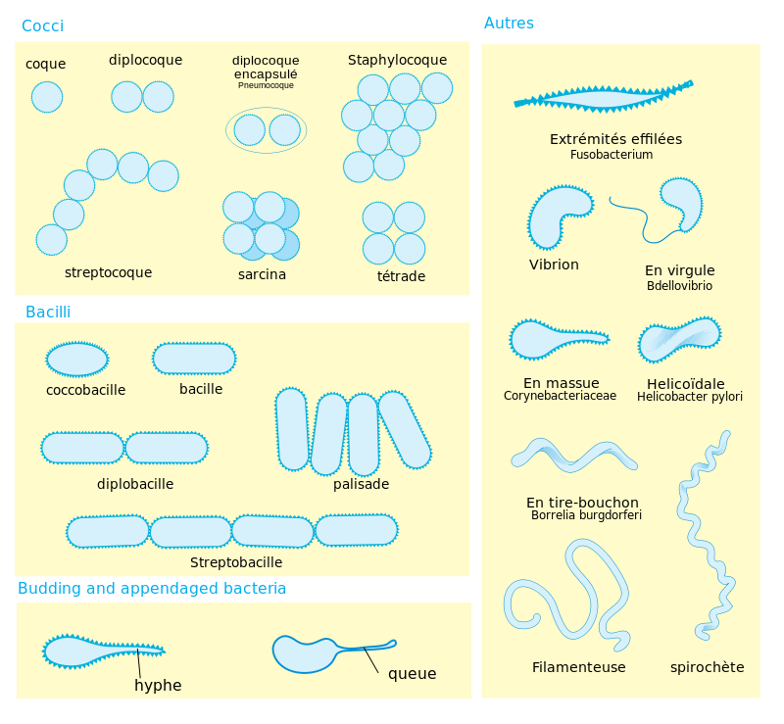

Slide 7
Rod-shaped bacteria are known as bacilli (bacillus):
Straight rod or bacillus.
Curved rod or vibrio.
Like cocci, bacilli can be associated in pairs (diplobacillus), or can form true chains. Sometimes the rods are curved (vibrios), and sometimes the rods are so short that they could be confused with cocci (coccobacilli).

Slide 8
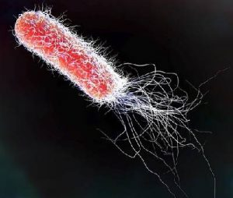
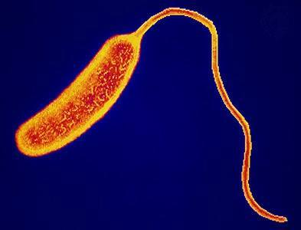
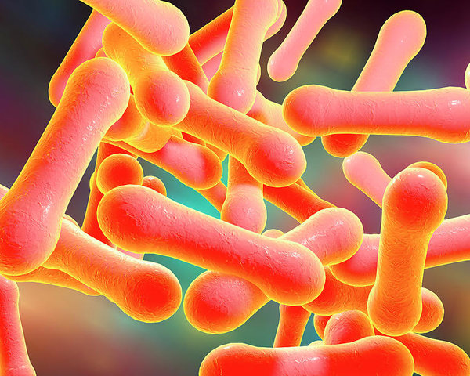
Escherichia coli
Vibrio Cholerae
Corynebacterium Diphtheriae
(palisade)

Slide 9
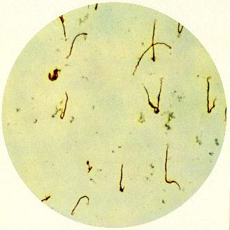
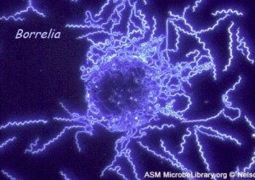
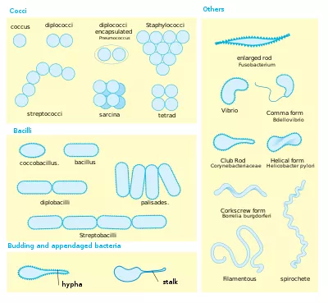
Spirillum shapes (Twisted Bacteria):
They are found in treponemes, leptospires, and spirochetes. They are distinguished by their length and the number of undulations.
Leptospira and Treponemes: 5 to 15 µm long Spirochetes: 30 to 200 µm
Borrelia burgdorferi

Slide 10
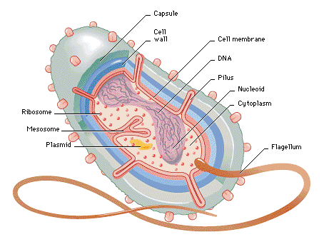
Organization of the Bacterial Cell
In the bacterial cell, we can distinguish constant elements, found in all bacterial species, and inconstant elements present in only certain species.
The constant (essential) ultrastructural elements are: the cell wall, the plasma membrane, the cytoplasm, the genome, and the ribosomes.
The inconstant (optional) ultrastructural elements are: the capsule, the plasmids, the flagella and the pili…..

Slide 11
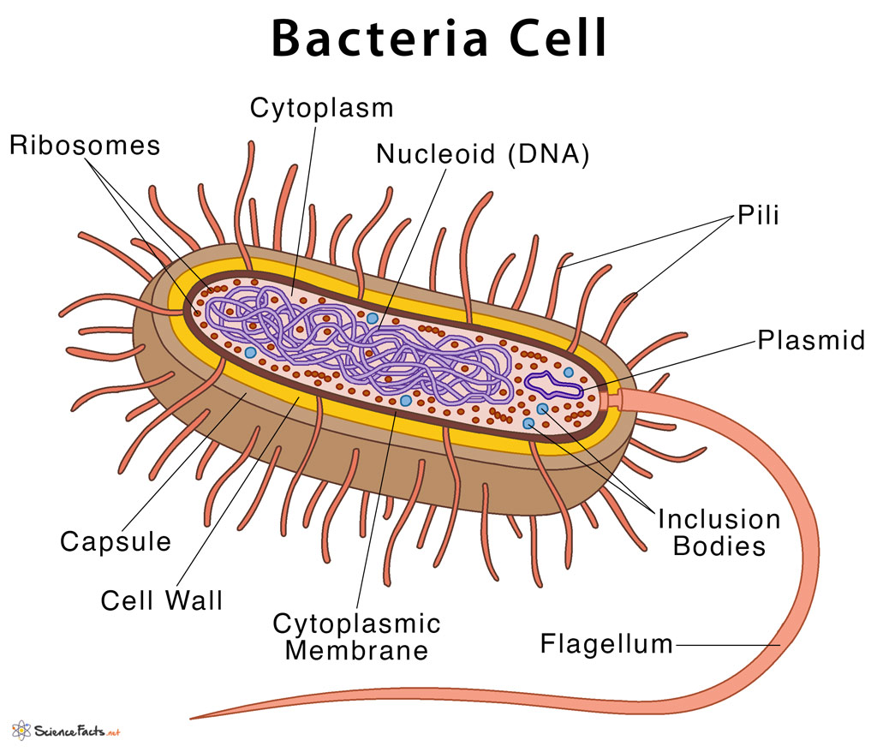
The constant (essential) ultrastructural elements are:
The cell wall: is a rigid envelope of varying thickness present in all bacteria. It gives the bacteria its shape and protects it against toxic substances; it is the site of action of ATBs (antibiotics).
The plasma membrane: surrounds the cytoplasm and forms the boundary with the external environment. It is composed of proteins and lipids in varying proportions depending on the fluid mosaic model. It is the site of metabolic processes such as respiration, photosynthesis, and the synthesis of lipids and cell wall components. It contains receptive molecules that detect and respond to environmental chemicals.
The cytoplasm: contains ribosomes (protein synthesis) and various organic inclusion bodies such as reserves for energy production and biosynthesis, glycogen, and lipid balls.
The genome (DNA): ensures genetic functions and cell division. At the intracellular level, bacteria have one chromosome in the form of a DNA filament, which supports heredity. The bacterial chromosome is generally circular.

Slide 12
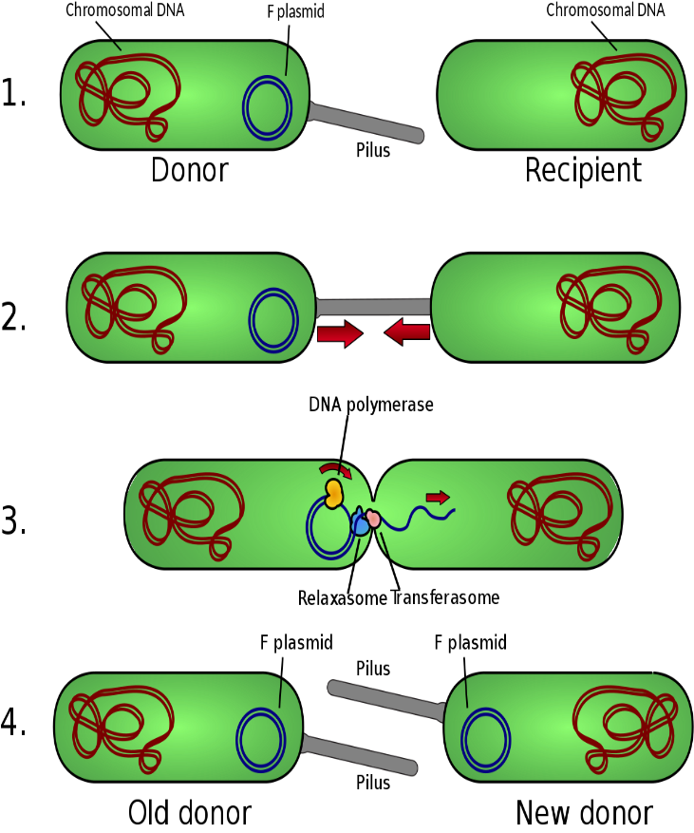
The inconstant (optional) ultrastructural elements are: the capsule, the plasmids, the flagella and the pili…..
The capsule: is a viscous substance, more or less thick, that surrounds the cell wall. It allows the bacterium to adhere more easily to other living beings while protecting it from phagocytosis.
Flagella: are long, very thin filaments used by several types of bacteria for movement.
Pili: Pili are outgrowths of the membrane of certain species of bacteria. They are thin tubes composed of protein subunits arranged in a helix. A cell can contain more than 1,000 of them. They are rigid and serve as a means of attachment to various surfaces, from which the bacterium can obtain its nourishment. Sexual pili are used to transfer genetic material between bacteria during a process called conjugation.
Plasmids: are extrachromosomal genetic elements capable of self-replication. Plasmids are small fragments of DNA, about 100 times smaller than chromosomal DNA. Among their properties, one of them, very important, is to confer on bacteria resistance to antibiotics or heavy metals (mercurial, cadmium, bismuth or lead salts, frequent components of antiseptics).
Bacteria multiply by binary fission, asexually. A parent cell will produce two genetically identical daughter cells, so genetic mixing is virtually nonexistent. To overcome this, there is conjugation: the transfer of DNA from one bacterium to another through direct contact (pili).

Slide 13
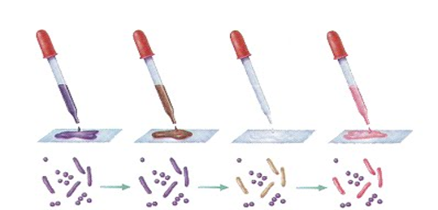
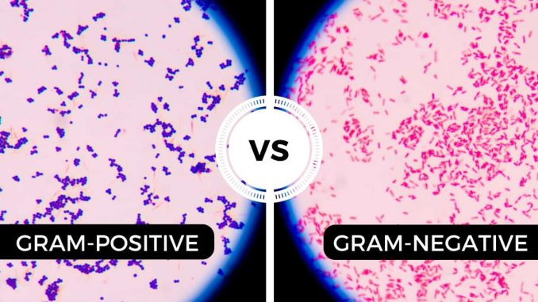
The Gram stain is named after the Danish bacteriologist Hans Christian Gram, who developed the protocol in 1884.
It is a staining technique that divides bacteria into two broad categories: Gram-positive and Gram-negative.
The technique's purpose is to:
- highlight the properties of the bacterial cell wall (its chemical composition).
classify bacteria to determine their resistance and sensitivity to antibiotics.
Its advantage is that it provides rapid information on the bacteria present
in a product or environment, both in terms of type and form.

Slide 14
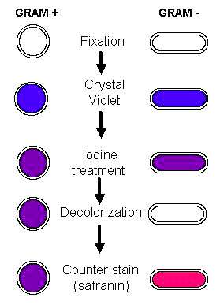
Principle of the Gram Staining :
It is based on the successive action of stain, crystal violet, iodine, and then a mixture of alcohol and acetone.
This staining method is based on a fundamental difference between the chemical composition of the cell walls of Gram-positive and Gram-negative bacteria.
Steps 1 and 2 : Purple staining of the bacterial contents and fixation of internal structures by Lugol's stain.
Step 3 : Decolorization of the cytoplasm of bacteria with a peptidoglycan-poor cell wall, which allows alcohol to pass through to eliminate the purple stain = Gram-negative bacteria.
Alcohols cause membrane fluidization.
Step 4 : Counterstaining with safranin, which stains previously decolorized bacteria pink.
Gram-positive bacteria remain purple (no passage through the peptidoglycan layer).

Slide 15
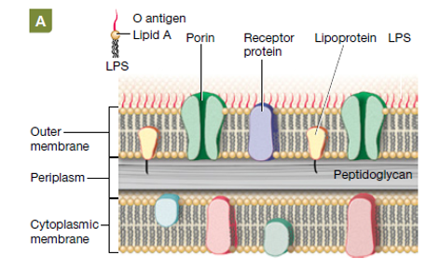
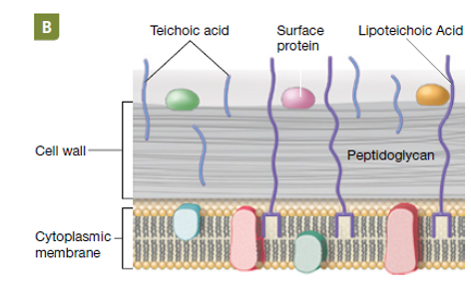
Gram negative
Gram positive
The walls of Gram-negative bacteria have a high lipid content (due to the outer membrane) and a thin layer of peptidoglycan. The alcohol in the bleach extracts the lipid, making the Gram-negative bacteria's wall more porous and unable to retain the Lugol violet complex, thus bleaching the bacteria. The thicker peptidoglycan traps the Lugol violet complex more effectively, making the Gram-positive wall less susceptible to bleaching.

Slide 16
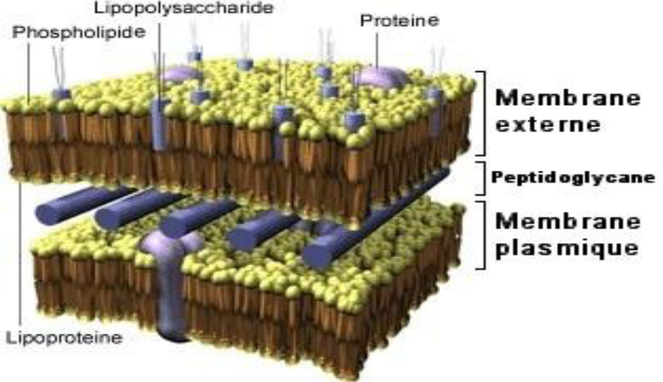
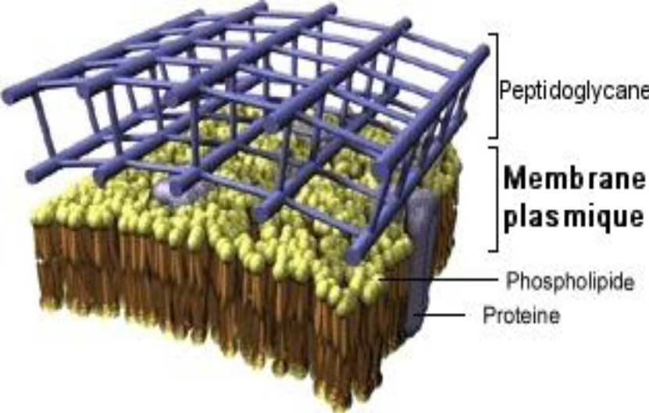
The cell wall is the characteristic envelope of the bacterial cell. It is a true exoskeleton that gives it its shape and allows it to withstand the high internal osmotic pressure. It is notably formed of a polymer: peptidoglycan (composed of N-acetylglucosamine and N-acetylmuramic acid).
The distinction between Gram-positive and Gram-negative bacteria is based on a difference in composition: The cell wall of Gram-positive bacteria is rich in teichoic acid, which is absent in Gram-negative bacteria, which have a cell wall richer in lipids.
Gram- Bacteria Gram+Bacteria

Slide 17
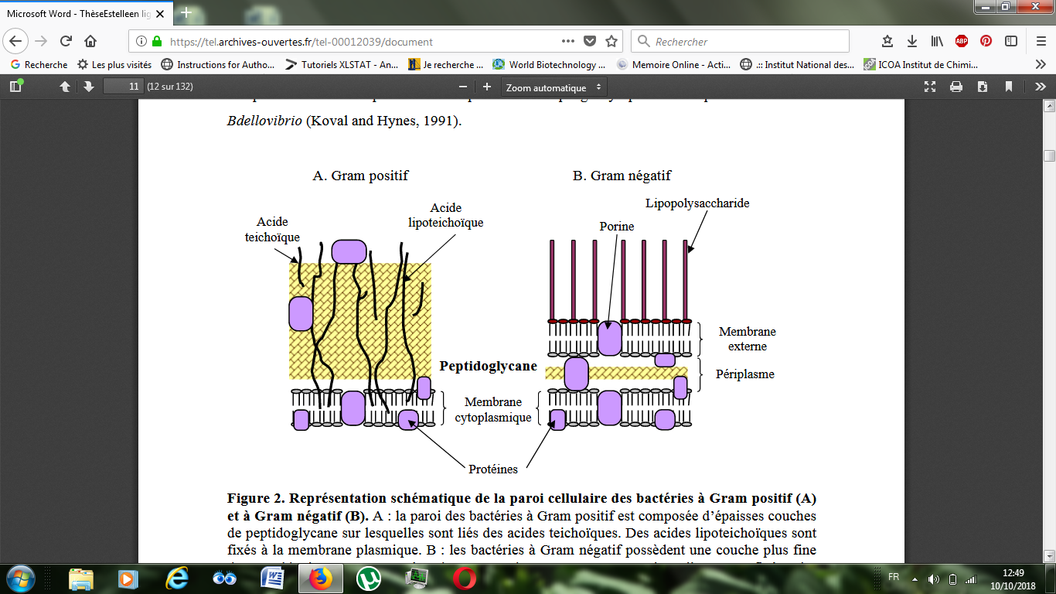
Teichoic acid is an acid that allows peptidoglycan to attach to the membrane of bacteria. It is present on Gram-positive bacteria but not on Gram-negative bacteria, which explains why Gram-negative bacteria have much less peptidoglycan.

Slide 18
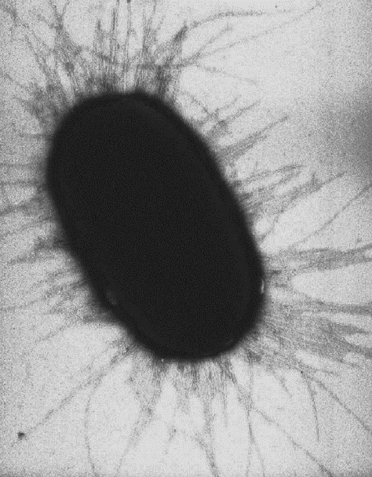
Chemical composition of the cell wall of Gram negative and Gram positive bacteria
 | The Cell Wall of Gram positive Bacteria | The Cell Wall of Gram negative Bacteria
Thickness | 20 à 80 nm | 10 à 15 nm
Appearance in electron microscopy | A thick layer | Two layers separated by a clear space
Outer membrane | - | +
peptidoglycan | Thick | Thin
Osamines | ++ | +
Amino Acids: Number Percentage | 4 to 10 different AA 24 to 35 % | 16 to 17 different AA 50 %
Teichoic acid | +++ | -
Lipids | 1 to 2,5 % | 10 to 22 %

Slide 19
This structural difference also explains why some antibiotics only act on Gram positive bacteria, while others only on Gram negative bacteria.
Example: Penicillins inhibit the final step of peptidoglycan synthesis. When this synthesis is inhibited, cell lysis mechanisms are triggered.
Some antibiotics work by targeting the bacterial cell wall. For example, there are antibiotics that contain D-amino acids similar to those used in peptidoglycan synthesis, and which will "trick" the enzymes that build the bacterial cell wall (without affecting human cells, which do not have a cell wall or do not use D-amino acids to synthesize polypeptides).
Note: Some bacteria remain insensitive to this staining, such as the Mollicutes, also known as Tenericutes.
Mollicutes are a class of very small bacteria, lacking a rigid cell wall and characterized by an unusually small genome. They are parasites of various animals and plants, living on or within the host's cells.
Examples:
Gram-positive bacteria: Staphylococci appear as a purple "bunch of grapes." Streptococci appear as a purple chain.
Gram-positive bacteria: E. coli appears as a pink bacillus.

